Slide 1
Check if numbers to immediate left and right of decimal makes a perfect square or not.
Arsh Panghal [ IIT2017048 ]
Anurag Gupta [ IIT2017049 ]
Akshit Bansal [ IIT2017050 ]
Prateek Nayak [ IIT2017051 ]

Slide 2
Problem Statement
Given a floating point number check whether its least significant integer part and most significant floating part together makes a perfect square or not.
Examples:
2343.434 => 34 => Not a perfect Square
2433.6878 => 36 => Perfect Square

Slide 3
General Idea
The first approach towards solving this problem is to construct a two-digit number after finding the position of the decimal.
After the number is formed, loop in the stored numbers and check whether it is present.
But since the use of the multiplication operator is not allowed, we have to design our own multiplication and division functions.

Slide 4
Design Of Multiply Function
First approach is to loop from unity to smaller of the two numbers and add the larger number into the result.
Second approach is using shift operations discussed in next slide.

Slide 5
Multiplication using Binary shift
The foundation of computer science is based on the fact that any number can be represented as sums of powers of 2.
For example: 10 = 2³+2¹
15 = 2³+2²+2¹+2⁰.
Using this fact we can multiply two numbers efficiently using shift operator.

Slide 6
Now if we represent the number (n) in binary notation left shifting the number x times i.e. n<<x is equivalent to multiplying the number by 2^{x}.
Example: (25)₁₀ = (1101)₂
Shifting 25 by 1 unit towards left gives (11010)₂ which is equivalent to (50)₂

Slide 7
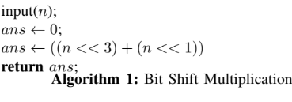
Combining above two facts :
10*10 = 10 * (2³ + 2¹) = (10 << 3) + (10 << 1) = 100
20*10 = 20 * (2³+2¹) = (20 << 3) + (20 << 1) = 200

Slide 8
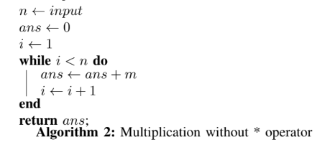
Brute Force algorithm
After finding the decimal digit in the number multiply its least significant integer digit by 10 and add most significant fractional digit.
Loop the squares and check for equality.
Time Complexity : O( k )
k : number of digits in integer part of ‘n’

Slide 9
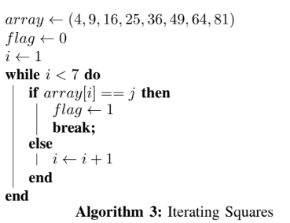
Better Approaches
Now after analysing the question we can infer that the number formed after concatenation will always be a single digit or two digit number.
Since number of 2 digit square numbers are only 10 we can reduce the computations by pre-storing the numbers in a lookup and checking.
Time Complexity : O( 1 )

Slide 10
Better Approaches
As the unit digit of a perfect square number depends only on the unit digit of its square root and unit digit can be any number from 0-9 so unit digit of a perfect square can never end with digits 2, 3, 7 and 8.
So any number having these digits as most significant floating point cannot form a perfect square.

Slide 11
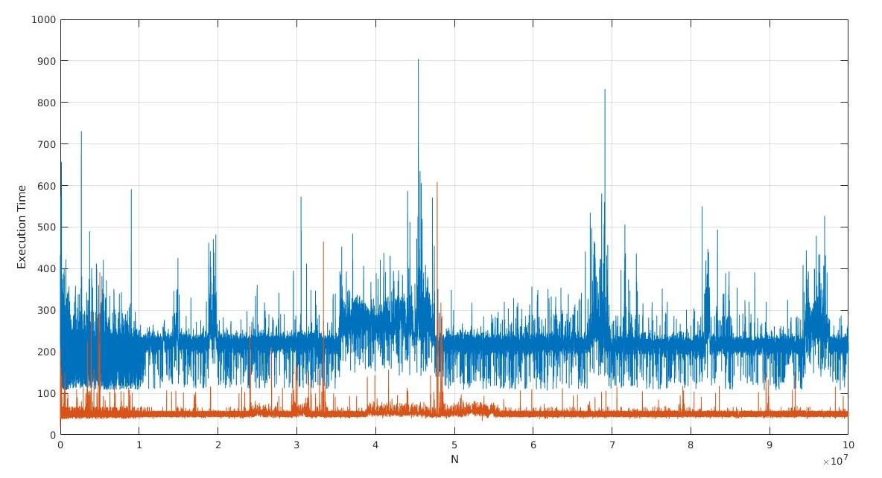
Result
Worst Time Complexity: O (k) [k: number of digits in integral part.]
Best Time Complexity: O(1)

Slide 12
References
IDAA432C Class Notes.
Introduction to Algorithm, (CLRS)
https://www.geeksforgeeks.org/stdstring-class-in-c/
https://www.geeksforgeeks.org/multiplication-two-numbers-shift-operator/
https://www.geeksforgeeks.org/string-find-in-cpp/

Slide 13
THANK YOU !

